Slide 1
TSC Playback Feb 2025

Slide 2
Agenda
What’s new in v0.38.0 (Dec 6th 2024)
What’s new in v0.39.0 (Jan 16th 2025)
What’s coming in v0.40.0 (End Feb ??)
Roadmap

Slide 3
Changes in 0.38.0

Slide 4
Secrets
UsernamePassword
UsernameToken
Encrypted when stored
Data
Last Set
Data
Last Set
username password description
username time+date
username token description
username time+date
Set (create/update)
Get (redacted values)
Get (with values)
Delete
Get/Deploy as yaml
Weird values can be encoded in base64
Who changed it last
When was it last changed
Token
Username
Data
Last Set
Data
Last Set
token description
username time+date
username description
username time+date

Slide 5
Version upgrades
Couchdb upgraded on the Galasa Service
Many dependencies on 3rd party packages upgraded
To guard against possible vulnerabilities
To keep Galasa up-to-date

Slide 6
Changes in 0.39.0

Slide 7
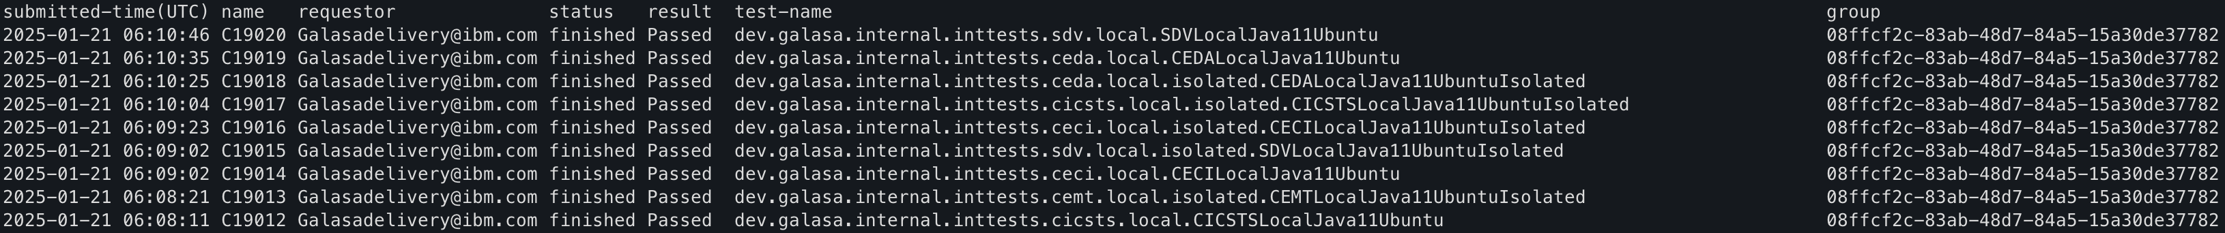
Submit runs in groups, Query them back
galasactl runs submit … --group myGroup
galasactl runs get –group myGroup
In addition to
--age xxx
--requestor xxx
--active xxx
--result xxx ..etc.

Slide 8
Before…
Github Repo
Github Repo
Github Repo
buildutils
extensions
webui
Github Repo
Github Repo
Github Repo
gradle
managers
helm
Github Repo
Github Repo
Github Repo
maven
obr
simbank
Github Repo
Github Repo
Github Repo
framework
cli
Isolated
Github Repo
Github Repo
documentation
Automation
Notes:
Too many repositories
No atomic commits spanning multiple repositories
Multiple PRs required
Versions hard to keep consistent
No one place to refer to for contribution guidelines

Slide 9
Now…
Github Repo
platform
Github Repo
Github Repo
webui
simbank
buildutils
wrapping
Github Repo
Github Repo
gradle
helm
Isolated
maven
Github Repo
Github Repo
framework
cli
Automation
extensions
Github Repo
managers
documentation
obr

Slide 10
Everything versioned at same level (eg: 0.39.0)
Before
Version of each part of Galasa managed separately
More complex to build
Harder to understand which version of Galasa was being relied upon
Harder to tell if you were up to date or not
Now
Version of every part of Galasa managed as one version
Simplicity to build and use
At a glance, see which version of Galasa you are using
Uplifting versions all together easier
automated scripts added to do this

Slide 11
Changes coming in 0.40.0

Slide 12
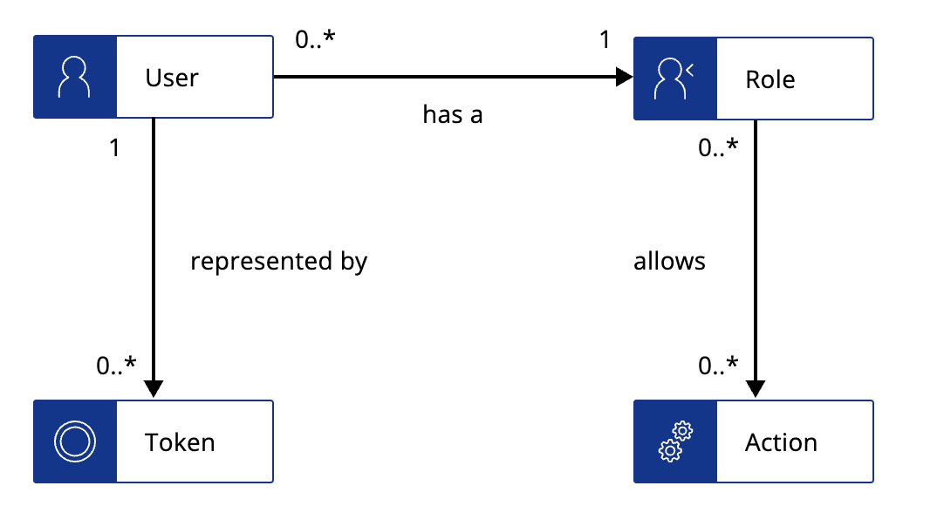
Galasa Role Base Access Control model
0..*
1
User
Role
hasA
1
0..*
represents
canPerform
0..*
0..*
Token
Action

Slide 13
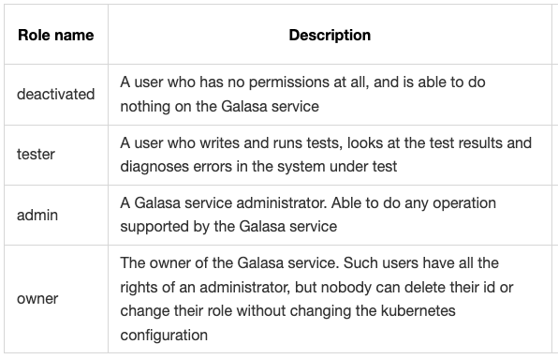
Roles

Slide 14
Galasa service configuration
Default user role can be set for new users
Owner can be specified in Kubernetes configuration
to change - you need to update the deployment…
a Kubernetes admin can recover a system with no active administrators

Slide 15
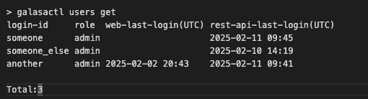
Roles on command line

Slide 16
Roles on command line

Slide 17
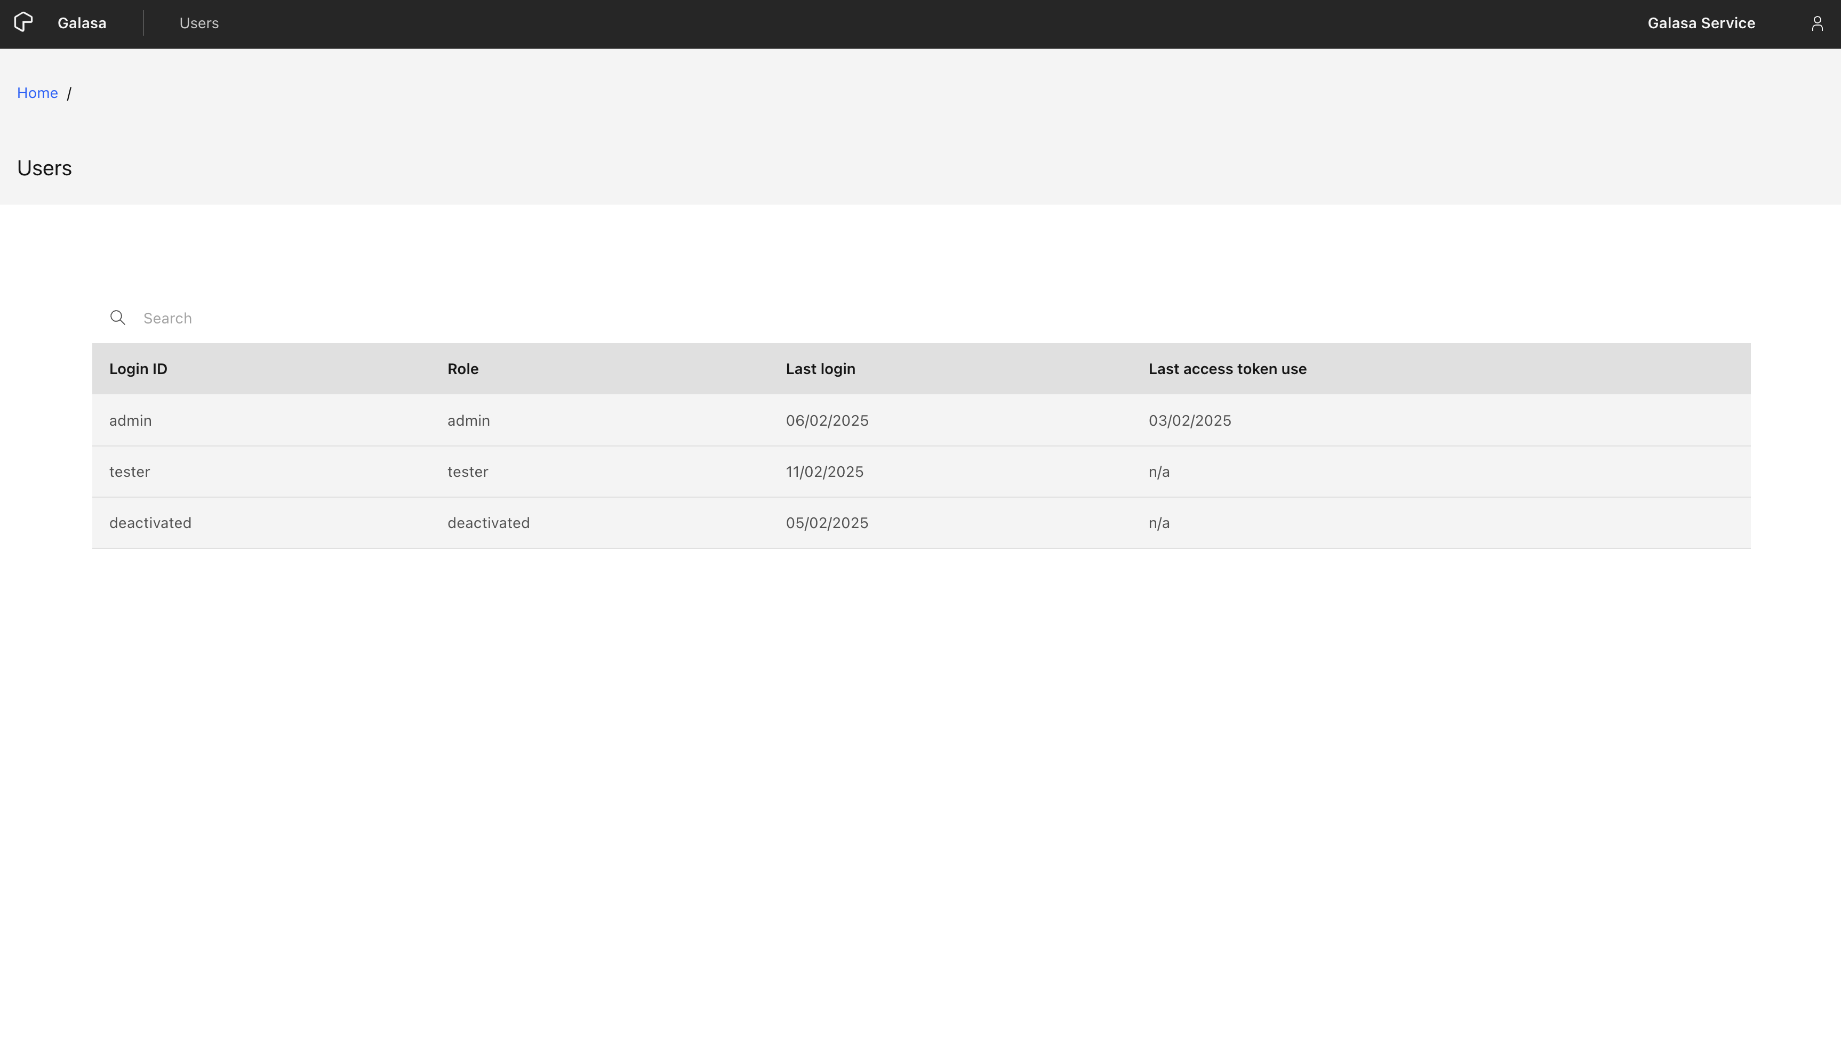

someone
someone_else
another

Slide 18
Changing roles
> galasactl users set --login-id mcobbett --role admin
Administrators
can’t change their own role
can change roles of other people
Non-admins
can’t change any roles of users
Owner(s)
Nobody can change the role of an owner
(except the Kubernetes system administrator)

Slide 19
Customisable VTAM Login Prompt
Documentation for Support customizable VTAM logon strings (#2109) #854
Ian Deeley , TAZ team
Allows a template for the logon string to be configured differently for each system
Eg: Is it LOGON APPLID(applid) or LOGON APPLID applid ?

Slide 20
CPS property changes
A CPS property can now have a blank value
Allow ‘@’ characters in property names
A property name of `person-contact-number-my_user_id@example.co.uk` … is now valid

Slide 21
Making Contributing Easier…
Branch
Fork
Develop
Develop
PR Review
PR Review
Merge
Merge

Slide 22
Benefits
Contributors on forks don’t need any permissions granted to them for the Galasa project.
This is still safe: PRs can’t submit to Galasa/build without review.
Fork users can build their own versions of artifacts in their GitHub organization.
Easily setup a build process on your own organization.
The GitHub actions build process is forked along with the code.
GitHub Actions allowance of the Galasa project doesn’t get used building PRs of forked repos.
It’s a big allowance, and funded by the Linux Foundation/Open Mainframe project

Slide 23
Roadmap

Slide 24
High Level Roadmap
Key: Completed and released Started Not Started
1Q 2025 | 2Q 2025 | 3Q 2025 | 4Q 2025 and beyond
More Secure Service draws tests from password protected repo (artifactory) (link) Add public certificates so tests can contact things over https (link) Role-based access (admin vs non-admin) (link) Others Upgrade etcd (link) Customer-specific requirements Better test infrastructure Customer Adoption of Galasa Generate interest through blogs, videos and conference sessions | More Secure Secure local secrets (link) Https instead of http inside the cluster (link) Access tokens have an expiry time (link) Release v1.0 Others Customer-specific requirements Secrets sync'ed from IBM Cloud Secrets Manager (link) More Gherkin requirements Customer Adoption of Galasa Generate interest through blogs, videos and conference sessions | Easier to use/maintain Schedule tests in queues CLI Configure Ecosystem streams (CRUD) CLI Monitor and Cleanup of DSS CLI Configure credentials (CRUD) Kafka-published test lifecycle change events Migrate to 'OMP' cloud account Others Web UI : query test results within a time bracket, requestor, passed/failed Web UI: Annotate a test run, see annotations CLI: Annotate a test run, see annotations Web UI : see test status details Web UI : view a run log Web UI : see which artifacts are downloadable Web UI : download selected artifacts Customer Adoption of Galasa Generate interest through blogs, videos and conference sessions | Configure Ecosystem Web UI Web UI configure CPS properties (CRUD) Test Scheduling Others Reporting Web UI Web UI Monitor and Cleanup of DSS Web UI Monitor and Cleanup of CPS space Web UI configure streams (CRUD) Integrate with other OMP projects Customer Adoption of Galasa Generate interest through blogs, videos and conference sessions

Slide 25
Thank you!

Slide 26
Continuous Delivery
Galasa Version | Release Date | Highlights
0.39.0 | Jan 16th 2024 | Every part of Galasa versioned with same 0.39.0 version marker Easier contributions: Forks and fork builds supported. Gherkin improvements. Query roles available. User has a role (read-only) everyone is an admin. Query test runs by the groupID set when they were launched. Version uplift on many 3rd party dependencies, and couchdb. Drop maven 2 support.
0.38.0 | Dec 6th 2024 | List access tokens by loginID. Gherkin improvements. CLI Secrets get/set/delete. Fixes. CLI delete users. Web UI: Settings page. See when you last used a token/logged in. Easier contributions: fewer repositories.
0.37.0 | Sept 17th 2024 | Java 17. Performance of Get runs. Delete runs. CLI handles multi-line CPS properties better.
0.36.0 | Aug 15th 2024 | Gradle 8, Gherkin scenarios and example tables, Sizable gherkin terminals, Revoke access token using the CLI, Couchdb upgrade.
0.35.0 | June 2024 | DB2 manager fix
0.34.0/0.34.1 | June 10th/12th 2024 | Remote CPS for local test runs
0.33.0 | May 2024 | Authentication mandatory. CouchDB upgrade. Updated gradle&maven plugins.
0.32.0 | March 2024 | Reset/Cancel runs which hang. Run local Gherkin tests. Eclipse plugins withdrawn
0.31.0 | Jan 2024 | Authentication (optional) CLI set/create/update properties in yaml format
0.30.0 | 2023-Oct 19 | CLI can set/get property values in Ecosystem CLI requestor is always the user id of caller
0.29.0 | 2023-July 5 | Security fixes
0.28.0 | 2023-June 15 | CLI get list of historical runs CLI get details of a historical run CLI download artifacts from a historical run CLI debug testcases in Eclipse/VSCode/IntelliJ
0.27.0 | 2023-May | CLI Get status of a historical run CLI uses $GALASA_HOME environment variable
0.26.0 | 2023-March 26 | CLI launches local test run
0.25.0 | 2023-Jan 23 | Stable builds
Note: Pre-release builds of Galasa code and Documentation are visible externally on main branch every build

